Slide 1

HPMA LONDON ACADEMY
ANNUAL REVIEW
2019-2020

Slide 2

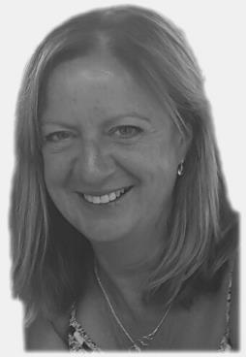

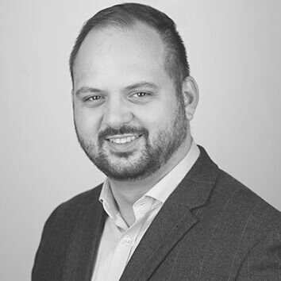
JANET LYNCH
VICE PRESIDENT 2019-2020
  The last year has seen continued growth and development for the London Academy, and it's been a privilege to be VP during such a positive period. The programmes delivered have been accessed and valued by huge numbers of workforce professionals, and have supported their careers and personal/ professional development. I've now stepped down a year after retiring from the NHS, and have been immensely proud of everything we've achieved, driven by Rachael, Diana and the Academy Board.
CRAIG DE SOUSA
VICE PRESIDENT 2020 -
The Academy has achieved a great deal over the last year and that is testament to the hard work of the team running the day to day operations but also to those that kindly volunteer their time and support to developing our unique and well regarded offering.
Looking forward to 2020/21, there are a number of challenges to work our way through with COVID-19, but this will give us the opportunity to test and try new things and build on our great achievements. In the coming year we will look at how we do more of what we’re good at and seek to expand our offering to more organisations in the capital and south east.

Slide 3


HPMA London Academy
https://youtu.be/STGbvU7Hpig

Slide 4
ABOUT THE HPMA LONDON ACADEMY
The only Academy delivering development for workforce professionals in the UK
Provides comprehensive programme of learning and development for workforce professionals from 57 healthcare organisations in London and surrounding areas.
The HPMA is a charitable organisation, governed by Trustees with a National Council of HR Director Vice Presidents from each branch of the HPMA.
HPMA London Academy is led by a Board of 9 HR Directors from member organisations and representatives from London Leadership Academy, NHS Employers, HEE and commercial partners.

Slide 5

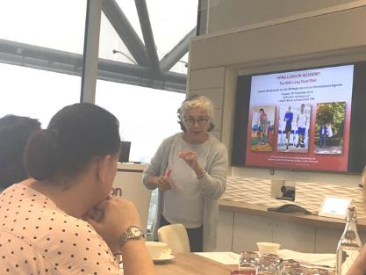
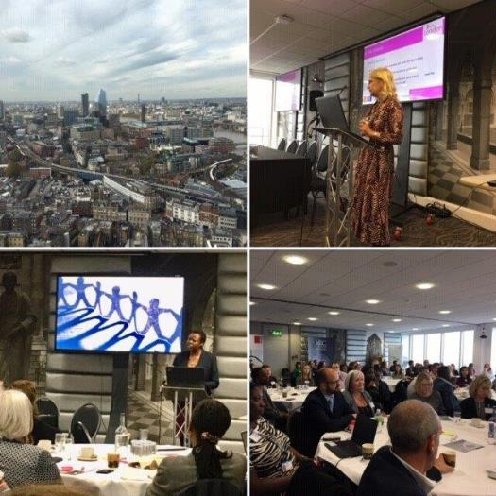

WHAT WE HAVE DELIVERED FOR OUR MEMBERS 2019 - 20 HIGHLIGHTS
CORE PROGRAMME: BE THE CHANGE
102 learning sessions covering personal effectiveness, supporting teams facing uncertainty, supporting teams to deliver high performance, supporting the aims of the business, developing core knowledge and enhancing organisational effectiveness.
TOMORROWS WORLD
Three sessions with Dr Pat Oakley for HRD, BP and Workforce Anaylsts. Discussing the future of the NHS from the viewpoint of all parts of the business
NETWORKS
The Strategic HR & OD network has met 4 times this year
The Deputy Directors network is thriving, both groups sharing ways of working, solutions and developing future thinking
CONFERENCE: BE THE CHANGE
70 delegates from all parts of the NHS HR community. Talks from Professor Em Wilkinson-Bryce, Peter Cheese, Dean Royles & Kevin Croft and a Dragons Den session, creating ideas on improving the NHS going forward.
ASPIRE DD Talent Pool and HRBP
2 programmes , 8 masterclasses, 5 ALS, 51 staff members

Slide 6

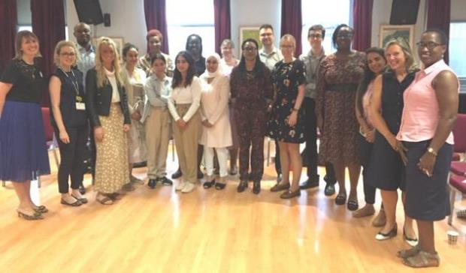


HOW WE HAVE SUPPORTED THE DEVELOPMENT OF FUTURE WORKFORCE LEADERS IN 2019-20
ASPIRE
Supporting Talent Management is one of our key objectives.
This year we launched the second ASPIRE HR Business Partner Programme in partnership with Orion Partners, with 18 participants. The feedback has been excellent
In addition, the ASPIRE Deputy Directors Talent Pool was launched in partnership with Cheryl Lee Associates. This is the first talent pool for workforce professionals in the country.
33 members of the pool have attended a development centre, participated in modules and learning sets and chosen mentors.

Slide 7



Average satisfaction rating of 89.4% our highest ever
2019 – 20 successes
2414 people on the mailing list of 57 member Trusts
2122 of the 2609 seats available for the programme were filled.
Average attendance rate of 87.2%
Increased our Trust members from 52 to 57 this financial year
Partnerships with over 32 companies & consultants to deliver our sessions
The ASPIRE Deputy Director Programme was shortlisted for a CIPD award in 2019.

Slide 8



LOOKING FORWARD: 2020-21
WE HAVE MANY AMBITIONS FOR THE YEAR AHEAD.
THESE INCLUDE:
A comprehensive core programme, Tomorrow’s World Today, which will focus on supporting workforce professionals through COVID19 and beyond
The launch of our third ASPIRE business partner programme
An exciting programme for year two of the ASPIRE Deputy Workforce Director talent pool
The launch of our indepth development initiative, providing organisations with the opportunity to commission tailored programmes
Launch of resource hubs to support staff in specialist functions.
The launch of a equality, diversity and inclusion project for the workforce profession

Slide 9

LOOKING FORWARD 2020-21
ASPIRE
The ASPIRE programmes go from strength to strength and it is wonderful to see so many of our alumni progressing into more senior roles and becoming mentors and role models for the talented leaders coming through the pipeline.
We will be commissioning a third Aspirant Business Partner Programme and deliver Year 2 of our Aspirant Deputy Director Talent Pool.

Slide 10


LOOKING FORWARD: 2020-21
DELIVERING EQUALITY, DIVERSITY AND INCLUSION FOR THE WORKFORCE PROFESSION
The HPMA London Academy will be working in partnership with workforce leaders across our member organisations to lead a programme of work with the aim of improving BAME representation in senior workforce leadership roles. Many of our members will be invited to participate in this important work

Slide 11
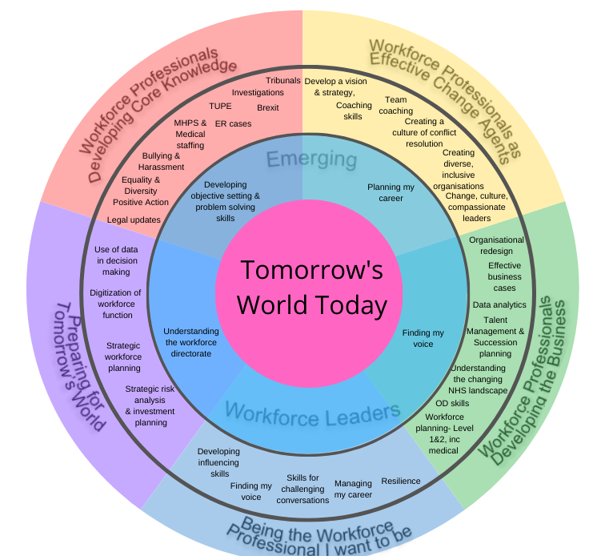
LOOKING FORWARD: 2020-21- TOMORROW'S WORLD TODAY:
Here is an overview of all our planned sessions

Slide 12

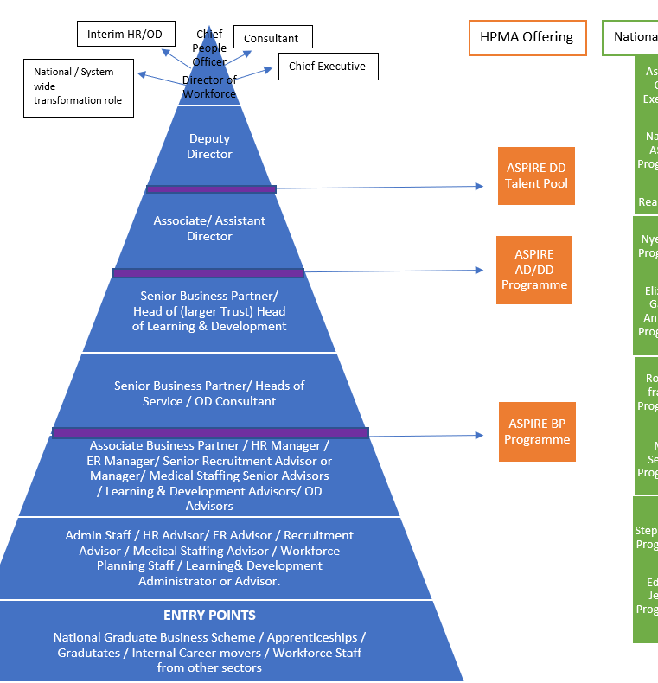


LOOKING FORWARD: 2020-21
Developing Your Career with the HPMA London Academy
The HPMA London Academy has developed this career pyramid as a starting point in plotting career pathways and development opportunities for workforce professionals.
We will be building on this to provide a clear development offer for members from the point of entry into the profession throughout the whole career pathway

Slide 13



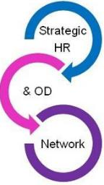


VALUE FOR MONEY
THE OFFER
All our member organisations have access to the full range of opportunities outlined in this annual review. We regularly review the take up of our development events to ensure that organisations are fully utilising the learning opportunities offered.
We have maintained Academy membership fees at the same rate for 2 years, whilst expanding the range of products on offer.
We continually review the quality and impact of our programme to ensure that members receive an exceptional programme to stretch thinking and stimulate innovation.

Slide 14

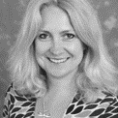
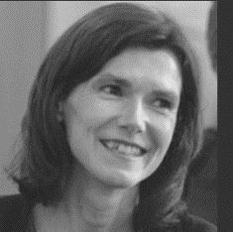
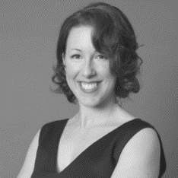
ABOUT US
THE HPMA LONDON ACADEMY TEAM & BOARD
RACHAEL TYLER
DIANA CLIFF
LORNA REEVES
Programme Director
Programme Development Manager
Event Co-ordinator
Craig de Sousa, VP HPMA, Director of HR & Corp Governance, Tavistock & Portman NHS Foundation Trust
Rachel Patterson, Deputy VP, Director of People & OD, North East London Commissioning Alliance
Claire Gooday, Director of HR, NEL Commissioning Support Unit
Danny Hariram, MSB Group Director of People Strategy & OD, MSB group
David Grantham, Director of Workforce and OD, The Royal Free NHS Foundation Trust
Paul da Gama, Director of HR & OD, West Hertfordshire Hospitals NHS Trust
Sally Quinn, Director of HR & OD , Camden & Islington NHS Foundation Trust
Wendy Brewer, Director of Workforce, West London NHS Trust
Mark Watson, Director of People (London), NHS England & NHS Improvement
Sally Story, Independent Consultant/ National HPMA Trustee
Anne-Marie Archard, Director, London Leadership Academy
Bernadette El-Hadidy, Head of Engagement – London, NHS Employers.
Nigel Burgess, Associate Director of Workforce & Information London, HEE
Geetika Bansal, Senior Associate - Employment & Pensions, DAC Beachcroft
Jodie Sinclair, Partner, Bevan Brittan
Julia Tybura, Managing Director, Zenon Consulting
Victoria Watson, Partner, Capsticks

Slide 15




Online Channels
TWITTER
FACEBOOK
WEBSITE
@HPMA_LondonAcademy
@HPMA_London_Academy
www.hpma.org.uk

