Slide 1

Delve OD Programme
2025
Nurture – Flourish – Grow

Slide 2
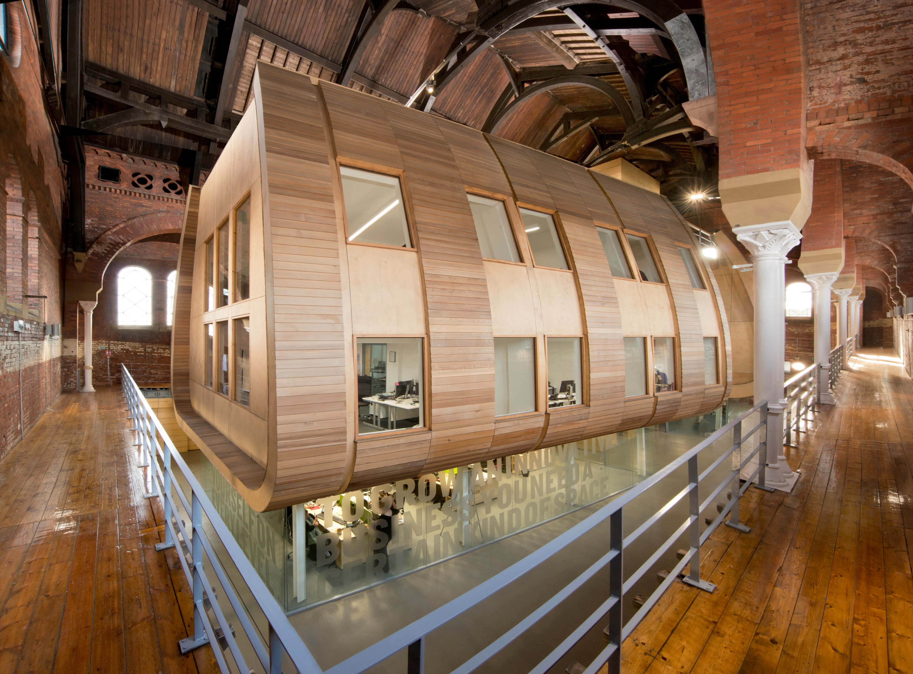

Our Purpose
We believe that work communities should be places where people can thrive

Slide 3

Our Mission
We equip organisations with the tools which support people to thrive, one conversation at a time.
We equip people with collaborative digital learning tools that disrupt formal thinking and create real change and motivation within businesses.
Talent Tool
OD Programme
Leadership Development
Team Development

Slide 4
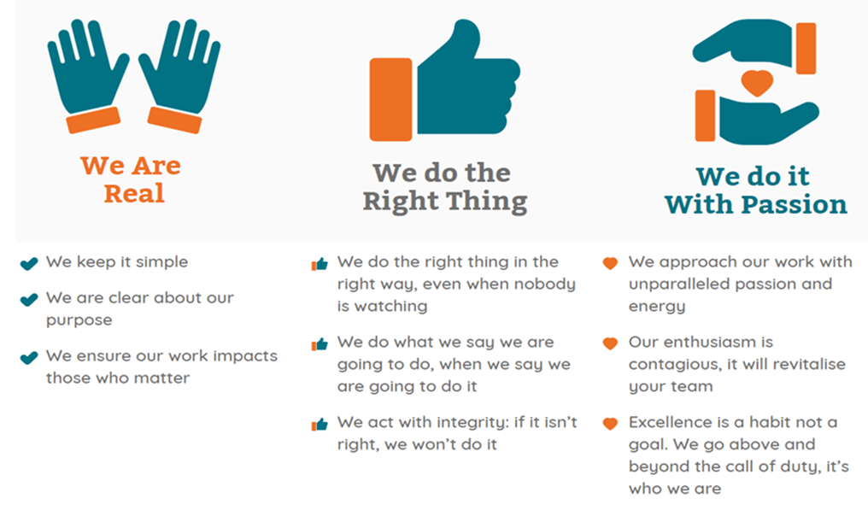
Our Values

Slide 5





OD Programme Clients
The Delvers provided specialist expertise in OD, alignment with a fluid, practical approach of our organisation and were also super real and very engaging as a team!
This programme is thought provoking and collaborative, providing clarity about how to do OD in a practical way. Excited to start putting it into practice!
Some of the people who have commissioned this programme

Slide 6
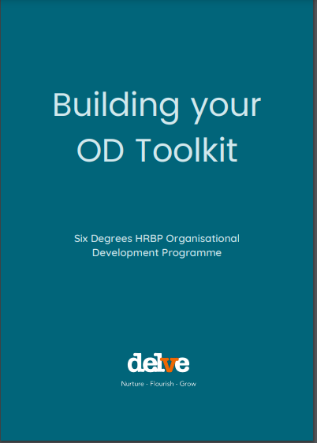
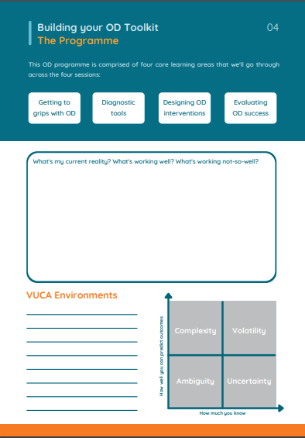
Our Approach
Delivered virtually over 4 half days with space for self-directed learning and support in between to put the learning into practice.
Your people professionals will be encouraged to bring a real-life people challenge to work on throughout the programme.
Our tried and tested programme includes a self-assessment and a practical toolkit for participants to take away and can be tailored to your specific organisation or system requirements.

Slide 7
Getting to grips with OD
Diagnostics
OD Interventions
Evaluation
Explore current issues and challenges from a OD perspective
Develop contracting skills to work across boundaries
Understand how HR and OD can influence strategically at a local and a systems level
Explore your ‘OD Selfie’, looking at areas of strength and areas for development
Using OD diagnostics and tools to support team development
Case studies, group work and discussion on best practice
Key OD skills and core competencies
Using coaching techniques to understand challenges
Tools to support your OD thinking to enable leaders and teams to thrive
Finding the fit - exploring your interventions and how to monitor and review
Theories of trust and the interplay with effective teamworking
Revisit your ‘OD Selfie’
Action learning approach to share how you’ve put the tools into practice
Explore key ways to measure ROI and impact of interventions
Developing a sustainable HR & OD support network to explore OD challenges
OD Selfie completed before and after the programme to measure knowledge and progress

Slide 8
Who is this programme for?
This programme is aimed at people who would like to develop an understanding of OD in practice and gain practical tools and techniques to support you in your role and could include:
HR Professionals
L&D Professionals
OD professionals who are new into role
Find out more about the programme here https://www.youtube.com/watch?v=4tyLaqMBGic

Slide 9
Preparing for the Programme
You will be required to bring a particular people challenge which you can work on throughout the programme. It is recommended that you access a mentor to support you in choosing a project. This could be a senior HR or OD professional within your organisation or system.
You will also be required to complete a pre and post programme OD self assessment to help you identify key areas of strength and development.

Slide 10
Programme Dates
21 January 2024
13 February
11 March
2 April
All sessions are 9.30-12.30 apart from session 4 which is 9.30-11.30

